Slide 1
Brazil Meetings Summary
May 22, 2018

Slide 2
Level 1 Calibration: Region
Step 1
Divide Brazil into Regions based on maturity group
Step 2
For each Region, define planting and cycle ranges using
MODIS/LANDSAT phenology
AgriTempo recs
Greenup and onset map
Single/double cropping map
Step 3
Choose three each among planting dates and cycle lengths
Each pixel, year group has a different set of early, mid, late planting date and short, med, long cycle (due to changes in variety)
Region 1
Region 2
Ex: year group y, region r, rotation s
Level 1 calibration: same parameters across a Region and year group
Region 3
Pixel 2: 3 planting x 3 cycle
Pixel 1: 3 planting x 3 cycle
Ex: year y
Ex: year group y, region r, rotation s
soy pixels (single + double)
Level 1 calibration parameters:
Climate-crop response parameters
Averaged management (Vm, beta)
Step 4
Alternately assume (early, mid, late) planting x (short, med, long) cycle for all pixels in each Region and year group
Calibrate to obtain 9 sets of parameters for each Region and year group, each containing average management package (Vm, beta)
Groups of years will have a single set of params for each Region x planting x cycle
Outcome of Level 1 Calibration:
Parameter sets for (n Regions) x (2 rotations) x (3 planting) x (3 cycle) x (y year groups), assuming averaged management
Notes:
Level 1 calibration: by “regions”
A “region” is defined by temperature, latitude, biome, Matopiba separately
In each Region, and for all years in each Region, all parameters will be the same for each management combo (3 planting x 3 cycle length)
In each Region, we need to constrain the planting date and cycle length in order to set early, middle, late planting and short, medium, long cycle length. To constrain the planting and cycle, use a combination of AgriTempo planting window recommendations, phenology curves calculated from satellite data – onset, greenup as the range. Each pixel may have a different range of planting and cycle in the region, depending on satellite data and AgriTempo recs. Divide the region into single vs double cropping before setting the range of planting dates and cycle lengths, because rotations have a big effect on the ranges. It doesn’t matter that single vs double cropping will change among years in the same pixel, because we’re ONLY using single vs double cropping to constrain varieties and planting date. For the entire region, apply a particular assumption, like late planting date x short cycle length. The actual planting date and cycle length may be different for each pixel, but the same assumption will apply for the entire region. For each assumption and region, all years will be used for calibration.
The outcome of Level 1 calibration will be 9 sets of parameters, each assuming a particular planting date type and cycle length type. The Vm here will be some averaged “management package” – in the form of fertilizer, irrigation, pesticide, etc. Most soy is no till, so don’t worry about no till/till. As this point, Avery suggests doing a take-one-out validation where we take subsets of the region, calibrate assuming each of the 9 planting x cycle length combos, run INLAND for the remaining validation subset, and use agreement with yield/phenology data to pick out the most likely managements of the 9. We think it’s good enough to keep all nine at this point. (perhaps set a likelihood to this as well?)
At level 1, we’re only describing varieties in terms of cycle length and single/double cropping. At level 2, add on Vm to describe varieties.
Note starting at level 1, we will have 9 sets of params for single cropping and 9 sets of params for double cropping. Essentially our biggest divisions are Regions x single/double.

Slide 3
Level 2 Calibration: Management Package
For each parameter set:
Positive error pixel-years
High management
Run INLAND for EACH Region, rotation, pixel-year
9 parameter sets
Low error pixel-years
Calibrate by error group
Med management
Negative error pixel-years
Low management
Step 1
Run calibrated INLAND for all parameter sets from Level 1 during Rally period
Tabulate residual errors (predicted vs observed phenology, yield) in each Region.
Each pixel-year will be considered separately (not lumped as in Level 1)
Step 2
Classify residuals for each pixel-year into negative, “low”, and positive biases
Calibrate management package parameters for each class of residuals, or “bin of pixel-years”
3 Vm and 3 beta values representing low, average, high level of management
Level 2 calibration parameters:
Management package (Vm, beta)
Outcome of Level 2 Calibration:
Given Region, rotation, planting date, and cycle length, we will have each pixel-year bin’s calibrated Vm and beta value
Each pixel-year will have 9 plant-cycles, but each plant-cycle will have a specific Vm and beta (i.e. they don’t add another branching level).
Notes:
The input to Level 2 will be 9 sets of parameters (corresponding to planting x cycle length) in each region. Level 2 will only calibrate/adjust Vm value, assuming all other parameters remain the same as in Level 1. We could also change rooting depth (which is related to management) if we have more than one point-year.
Two ideas:
Idea One. There will be a different Vm calibrated for each year and for each pixel (or group of pixels).
Idea Two. From Level 1, take a look at yield residuals (between predicted and observed). Make a CDF of residuals, divide into negative, close to zero, and positive errors and assume these three ranges represent different management choices. We will have three sets of errors “types”, and presumably have a way to set three specific Vm values corresponding to each of these errors. This will give us three Vms x 9 parameter sets from Level 1. Dividing the Vm into three regions, instead of Idea One which calibrates a specific Vm for each pixel/year, gives us more data to work with, so we could go on to calibrate rooting distribution (beta) and be more physical with management.
The outcome of Level 2 calibration will be an idea of what Vm would have to be to get a given yield/phenology dataset and a given planting x cycle length combo. There will be a single calibrated Vm value per pixel/year for a given planting x cycle. We will look at all Vm values in all pixel/years within each planting x cycle to get a sense of Vm ranges. We will pick out three (low, middle, high) Vm values within each region x 9 planting x cycle. We end up with parameters for 3 Vm x 3 planting dates x 3 cycles in each region, ready to run for SCYM.

Slide 4
SCYM
Or retain each possibility separately for SCYM regression?
Phenology data gives many possible planting dates, cycle lengths, rotations and their likelihood
Parameter set 1 and corresponding Vm, beta
Soy pixel-year within the Rally period
Weight predicted yield by management likelihood
INLAND
Parameter set 2 and corresponding Vm, beta
Choose best RS obs dates by R² and agreement with yield data
For each region and rotation, regress weighted yield in each pixel-year vs. pseudo RS and weather
Outcome of SCYM:
A set of statistical relations for each region and rotation of the form yield = fcn(weather, RS observations)
Notes:
The input to SCYM will be INLAND for each region of Brazil, calibrated for nine possible planting x cycle lengths, each with a set of 3 Vm’s that were calibrated in Level 2.
We will have two sets of regressions, one for single and one for double.
To get the yield regression equations, we will run INLAND for all 9 planting x cycle x 3 Vm values in each region. We will run INLAND for all 27 sets of parameters. For each of the 27, we will run INLAND for actual weather, and get yield. Note that we are not limited to using only the 3 planting x 3 cycle calibrated parameters as our management. We can simulate (exogeneously) any planting date we want with INLAND – the scenarios come from INLAND inputs, and the different parameter sets are for error (they’re not scenarios!)
Maybe we will then average the yields by likelihood of each management (where management is planting x cycle length), or we will just use all yields separately. Note that Vm will be assumed “known” for a given pixel/year and we won’t assign a likelihood to that. We will then put the predicted yields into regression along with pseudo phenology calculated from INLAND and actual weather.
How will we use yield, phenology data to pick likely observation dates when we don’t know the actual Vm? – we would need to assume a Vm in order to do this so it’s not very feasible. We don’t have a perfect model like SCYM requires. We could pick by R2 of calibration only.
Instead of having separate regressions for each Vm and planting and cycle, we can just do a single set of yield regression equations, assuming phenology captures variations in all 27 combinations.
Phenology SCYM regressions: instead of having separate phenology equations for each management, can do phenology = fcn(weather, Vm, planting, cycle). Can use Vm as exogenous input to generate phenology information in different management cases.

Slide 5
Prep work: by mid June
Examples of LAI info on soy pixels for calibration
Mask of single/double cropped areas – pick the Morgen class for the Rally pixels so Gabriel can see how they relate to onset-greenup
Compile soymap and yield data – overlay Pequisa agri municipal data as a “check”
Phenology curves of soy pixels
Determine representativeness of yield data
Decisions
How does Dave interpolate gridded weather?
Landsat vs MODIS
Ways to get satellite data -> full phenology curve
Questions
To calc vegetation indices – use Landsat surface reflectance or TOA?
Equations for LAI from vegetation indices – soybean specific papers?
Cloud masking – simpleCloudScore in GEE is good enough?
Notes:
All weather data will be interpolated (Tmin, Tmax, Tavg, wind speed, specific humidity, precip, radiation); interpolation will happen during the process of going from pixel to list
Classify pixels into region in the native weather data grid
Ask Dave – what does he do for gridded weather? What dataset does he use? Does he interpolate?
My work:
Bottleneck: Ask about datasets. Ask about cyberinfrastructure. Need: onset, Rally da Safra, LC Morgen soymap, Mapbiomas, other land use classifications, single vs double crop maps
Compile soymap and yield data
Determine rep of yield data
Select new soy pixels if necessary
Tie LAI info to the selected and yield soy pixels

Slide 6
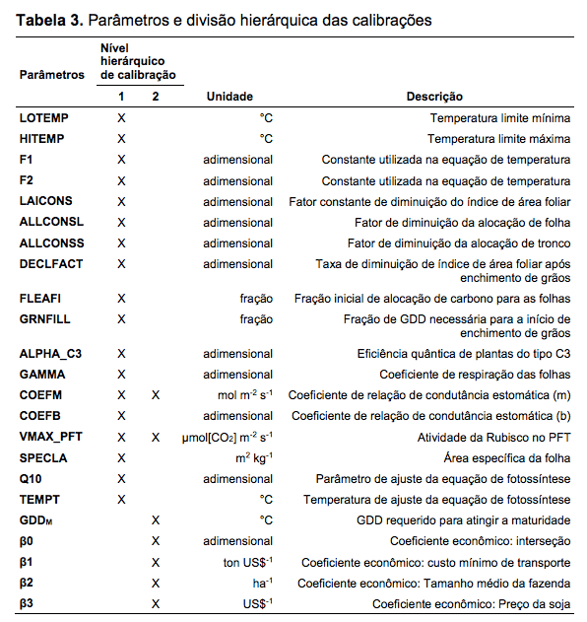
Calibration parameters of INLAND
Raphael Pousa dos Santos Master’s thesis

Slide 7
Landsat band designations
https://landsat.usgs.gov/what-are-band-designations-landsat-satellites

